Slide 1

Agenda
AEM 6.4 Overview
Building Sites
Style System
Repository Cleanup
Classic UI Status
Supported Environments
Content Services
Single Page Applications
1

Slide 2
AEM in Numbers and Dates
~55% of hostnames running AEM are on 6.3 (~30%) and 6.2 (~25%)
We estimate around ~32’000 servers running AEM
We estimate around ~120’000 domain names running on AEM servers
AEM 6.4 was announced on February 8th
AEM 6.4 will be generally available in April 2018
2

Slide 3
What’s New in AEM 6.4
Sites
Assets
Forms
Managed Services
Style System for Components
Experience Fragments incl. integration with Adobe Target
Custom Content Fragments models
Single Page App Framework powered sites
Extended publish for AEM Screens
Enhanced Translation integrations
CC In App Panels
Enhanced Smart Tags
Smart Translation Search
Smart Crop & Smart Imaging
Metadata Enhancements (Cascade/Contextual, Bulk Import & Export)
Usability Improvements (Browse, Search)
Reporting Enhancements
Brand Portal Improvements
Multi-channel authoring of customer communications
Forms Conversion at scale using AI
Enhanced Data integrations
Simplified authoring, Enhanced workflow and configurations
AWS & Azure support
Continuous Integration / Continuous Delivery
Infrastructure & tools
CI/CD pipeline setup
Code inspection
Functional testing
Performance/Load testing
Security testing
Graphical User Interface
Foundation
Minor touch upgrade (6.3), Online Tar Revision Clean-up performance, Indexing resilience and lower impact, Maintenance & Monitoring Improvements , Repository restructuring
3

Slide 4
Core Components
Production-ready components
Clean Markup: HTL templates, Semantic HTML, BEM class name notation, Data attributes for JS binding.
Configurable: The component capabilities that the author can use are defined in the template editor.
Extensible: The HTL template and SlingModels implementation can be extended or customized.
Consumable: The SlingModels can be consumed as pure JSON form to be rendered elsewhere.
Versioned: The components can evolve without breaking existing implementations.
4

Slide 5
Core Components
Page: Responsive page that works well with the Template Editor.
Title: Headings configurable to allow levels 1 to 6.
Text: Plain or rich text with configurable capabilities.
Image: Smart image display with configurable capabilities.
List: Lists pages that match the configured criteria.
Breadcrumb: Lists the hierarchy of parent pages.
Form Container: Form paragraph system.
Form Button: Submit or scriptable button.
Form Text: Text input field (text, text area, email, phone, date, number).
Form Options: Multi-options input filed (checkboxes, radios, drop-down, multi-select).
Form Hidden: Invisible input field, used for sending information along a form.
Navigation: Site navigation that handles language structures, live copies and redirections.
Language Navigation: Displays the language structure of a site.
Quick Search: Incremental search field.
Sharing: Facebook and Pinterest widgets.
5

Slide 6
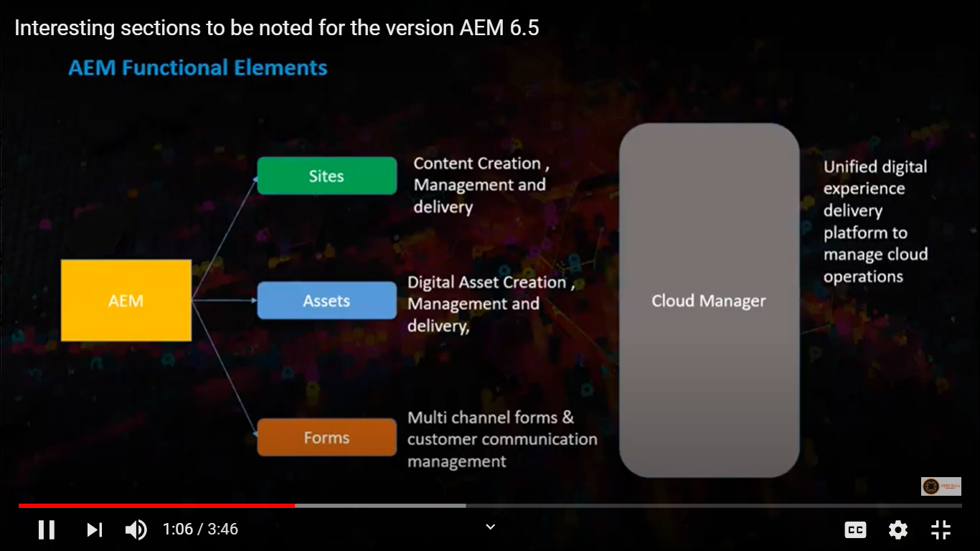

Slide 7
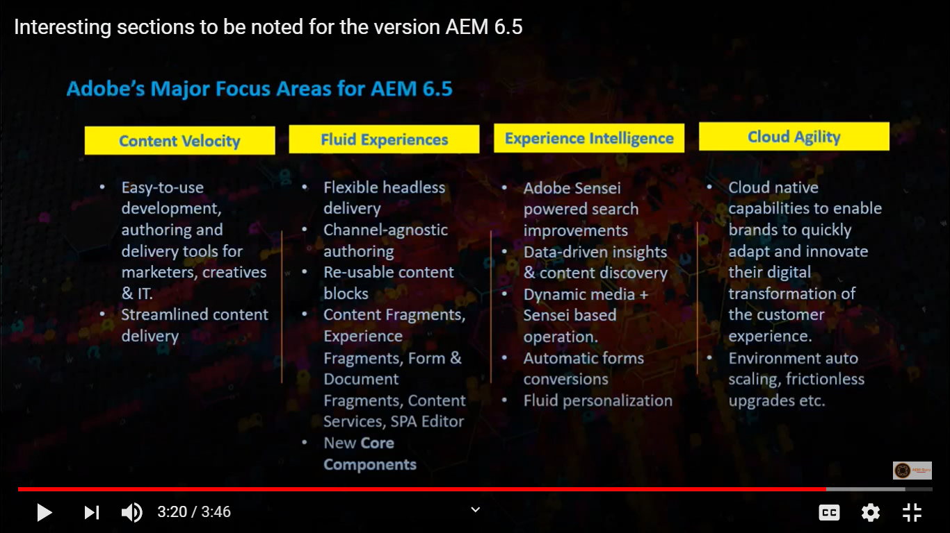

Slide 8
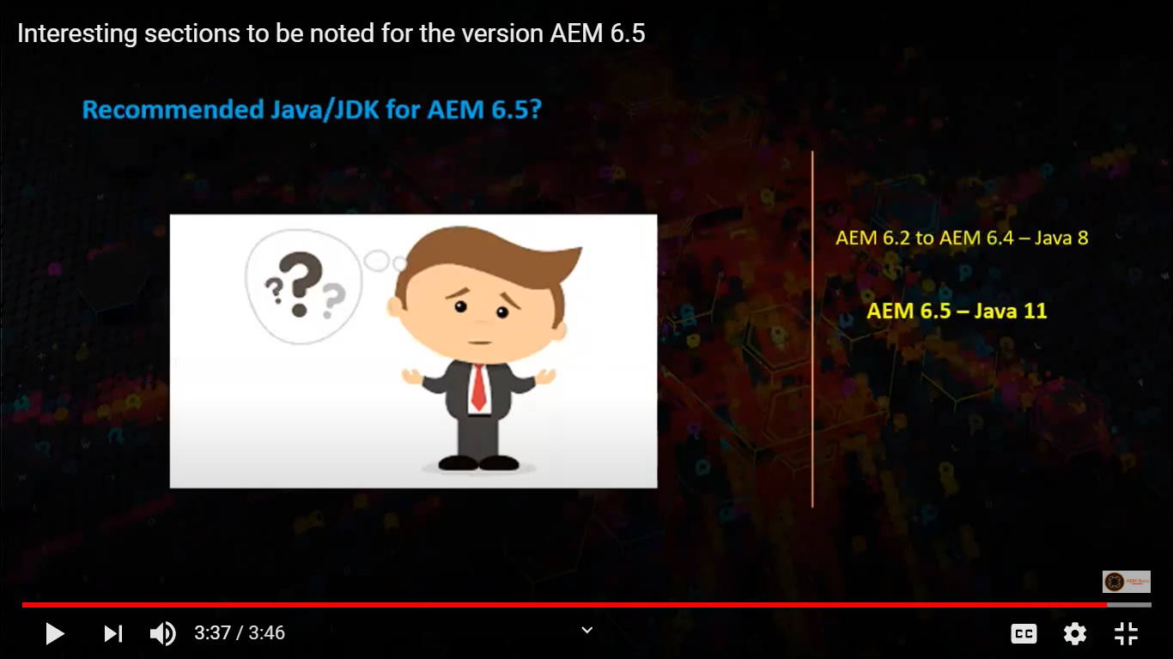

Slide 9
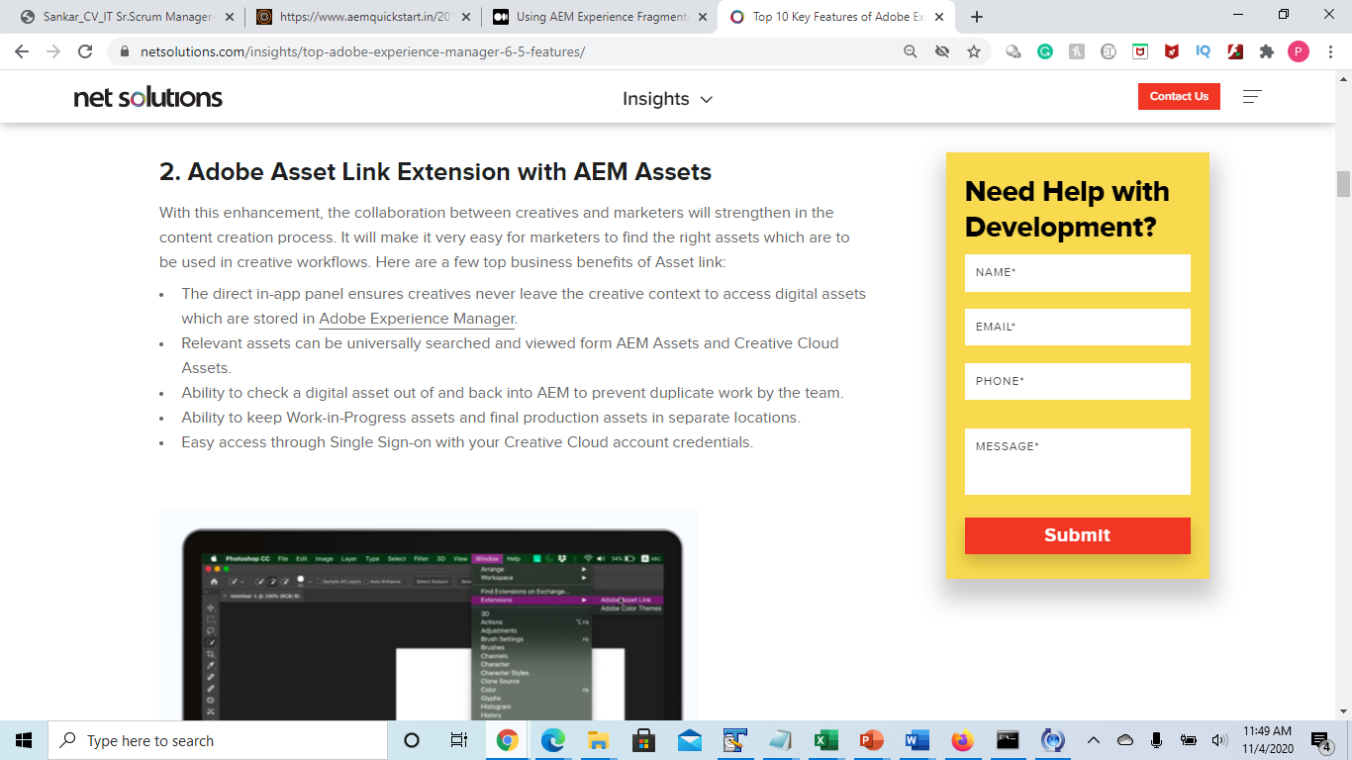

Slide 10
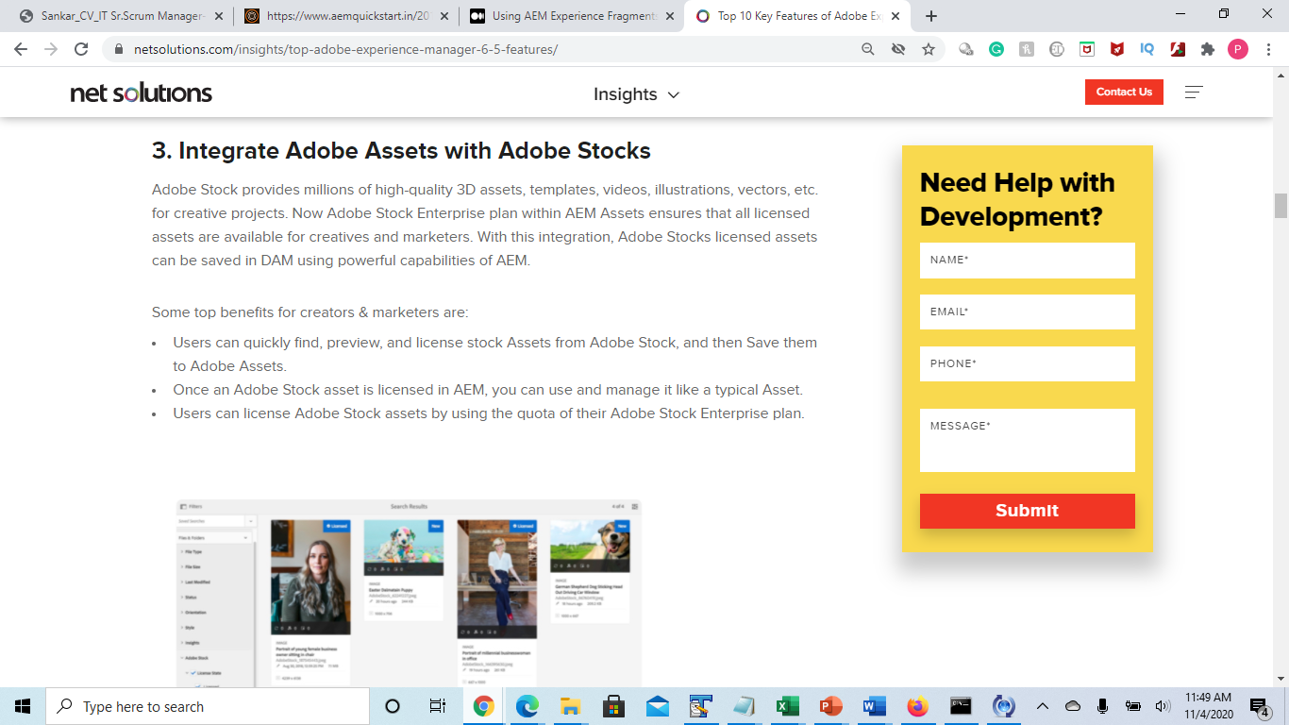

Slide 11
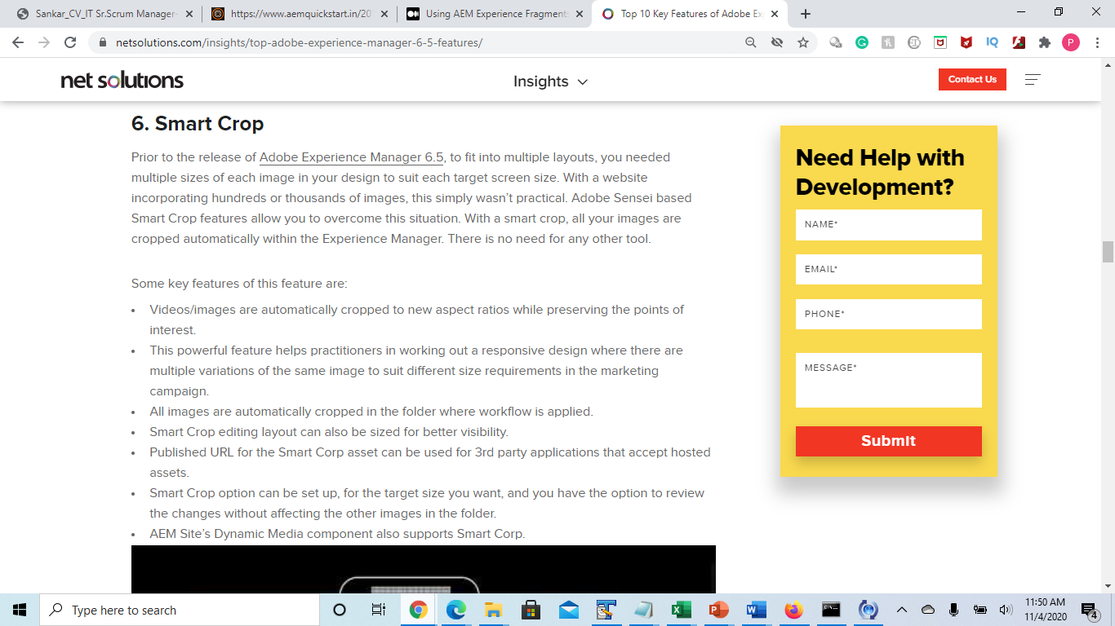

Slide 12
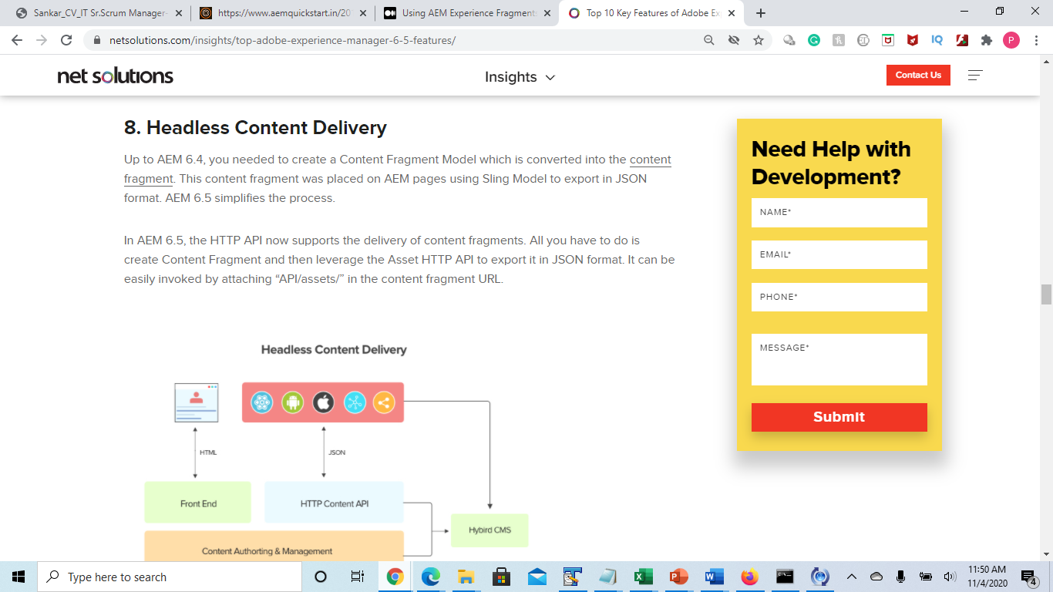

Slide 13
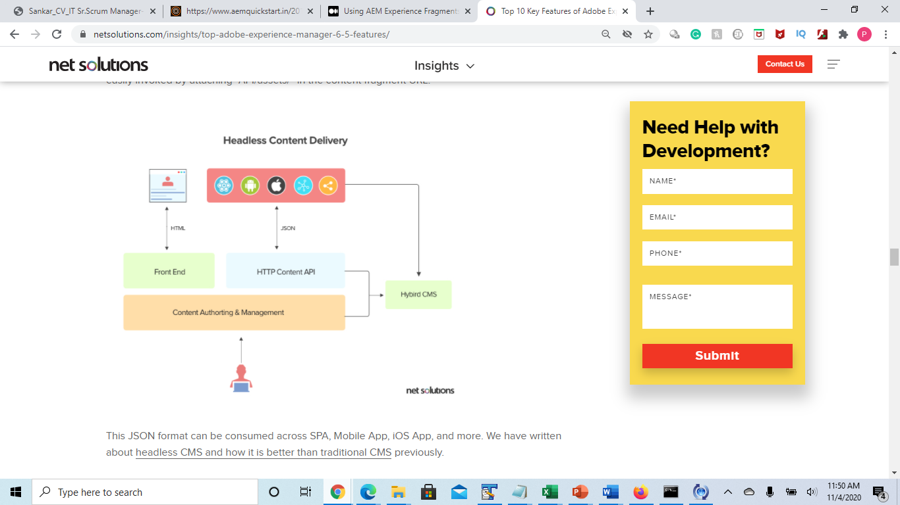

Slide 14
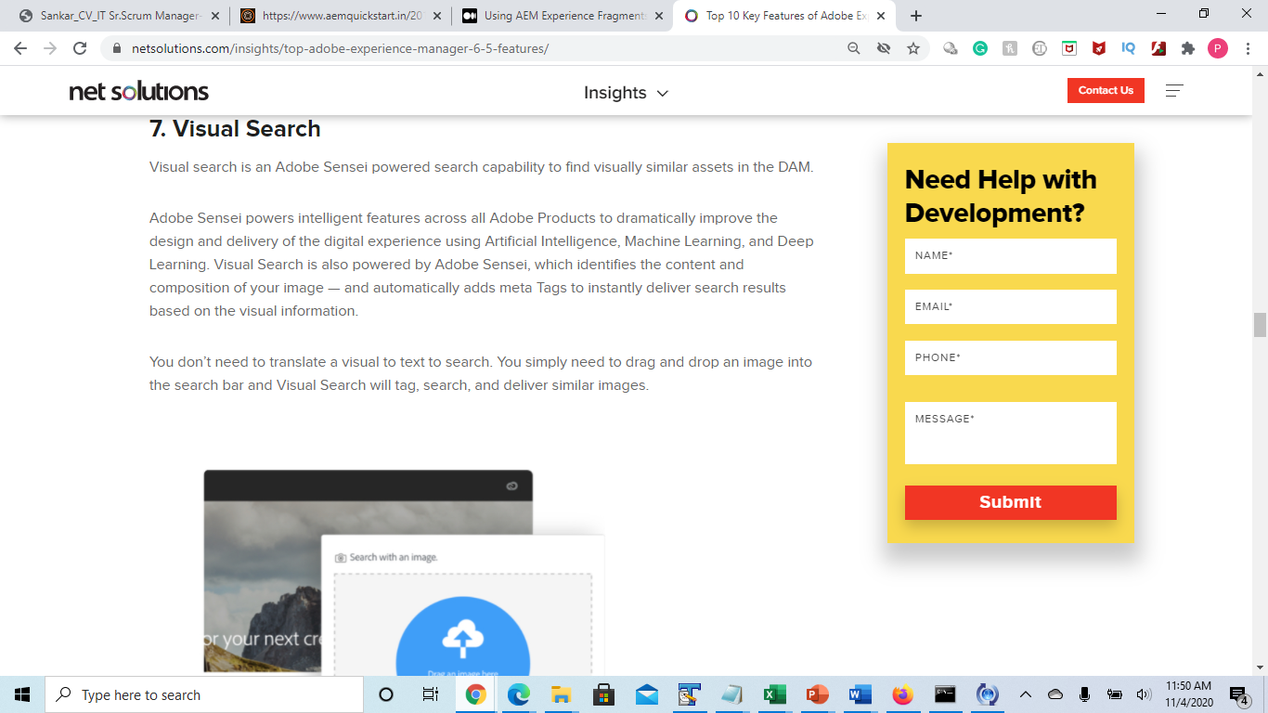

Slide 15
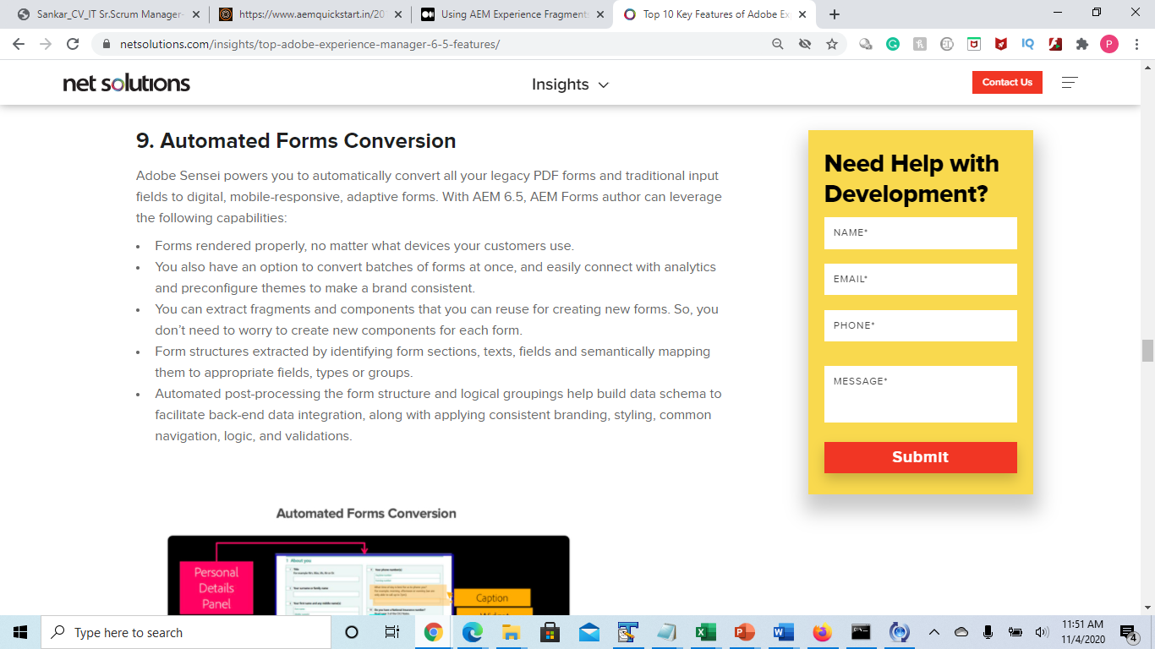

Slide 16
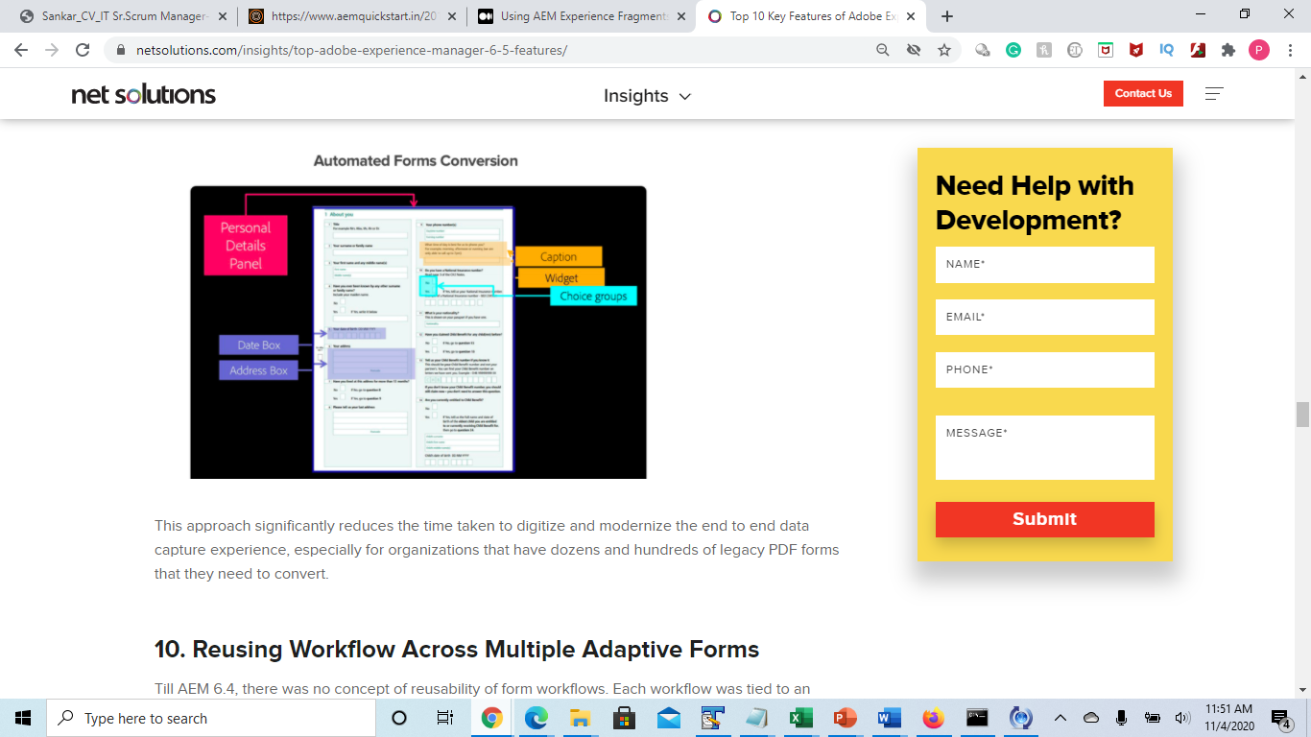

Slide 17
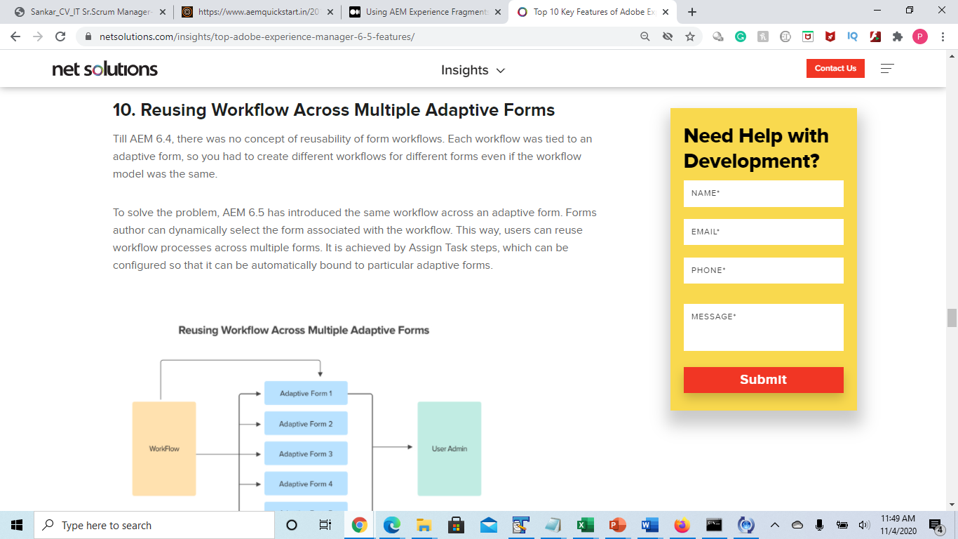

Slide 18


Style System – An Example
Components on the page:
Hero banner
Rich text
Highlighted banner
Image and text
Text and image
© 2018 Adobe Systems Incorporated. All Rights Reserved. Adobe Confidential.
18

Slide 19
Style System – An Example
Components on the page:
Title, text, link(s), image (background)
Title, text, link(s), image (centered)
Title, text, link(s), image (highlighted)
Title, text, link(s), image (image left)
Title, text, link(s), image
© 2018 Adobe Systems Incorporated. All Rights Reserved. Adobe Confidential.
19

Slide 20
Style System – An Example
Single component instead:
Title
Rich text – optional
List of link(s) – optional
Image – optional
With component styles:
Image as background
Center text
Highlighted
Image on the left
© 2018 Adobe Systems Incorporated. All Rights Reserved. Adobe Confidential.
20

Slide 21
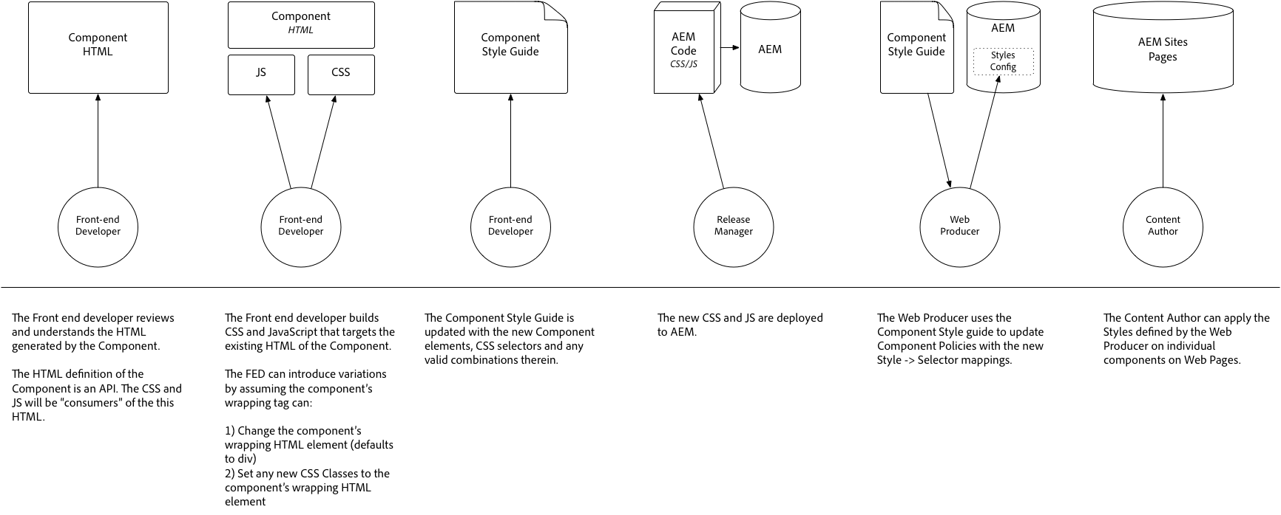
Front-end Designer & Developer Workflow
Starting 2018 with AEM 6.3 SP2 and 6.4 with introduction of the Style System:

Slide 22

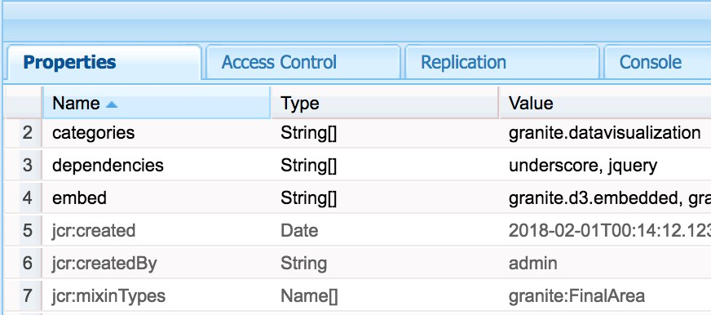
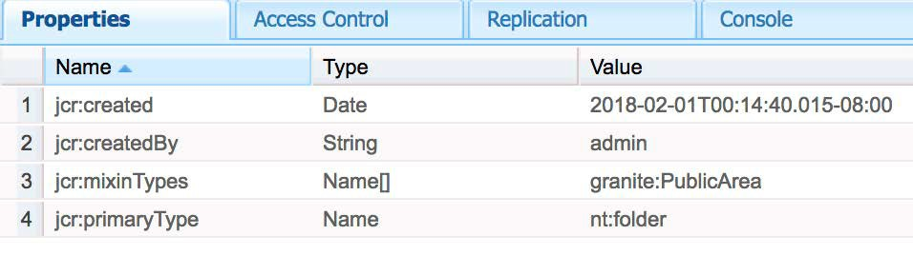
Repository Classification
Public (granite:PublicArea) – Defines a node as public so that it can be overlaid, inherited(sling:resourceSuperType) or used directly(sling:resourceType). Nodes beneath
/libs marked as Public will be upgrade safe with the addition of a Compat Package. In general customer apps should only leverage nodes marked as Public.
Final (granite:FinalArea) – Defines a node as final. Nodes classified as final cannot be overlaid or inherited. Final nodes can be used directly via sling:resourceType.
Subnodes under final node are considered internal by default.

Slide 23
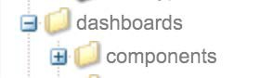
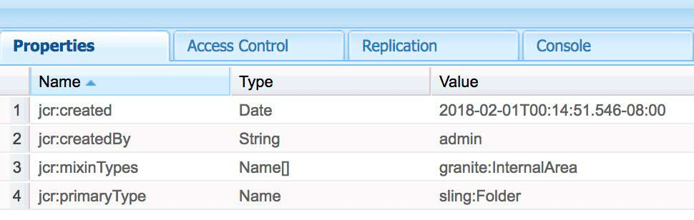
Repository Classification
Internal (granite:InternalArea) – Defines a node as internal. Nodes classified as internal cannot be overlaid, inherited, or used directly. These nodes are meant only for internal functionality of AEM.
No Annotation – Nodes inherit classification based on the tree hierarchy. The /root is by default public. Nodes with a parent classified as Internal or Final are also to be treated as Internal.

Slide 24



Repository restructuring for easier upgrades
6.3 and prior, ambiguity over ownership of /etc/* caused this:
AEM install customer release
AEM custom
AEM upgrade
/etc
/etc
/etc
AEM
6.4 moves content out of /etc, with guidelines on who owns what and how to extend that will help in future releases
AEM 6.4 install customer release AEM upgrade
/libs /libs
/libs
AEM
AEM AEM
/apps
/apps
custom custom
/conf
/conf
custom custom

Slide 25
Repository restructuring for easier upgrades
Extensibility patterns – public documentation will map /etc content to its appropriate pattern:
1) Context-aware configuration
2) Overlay in /apps
A multi-layered configuration approach
For content moved from /etc to /libs/settings
Example: /etc/workflow/notifications →
/libs/settings/workflow/notifications
The more traditional layered approach
For content moved from /etc to /libs, but not under settings
Check documentation on a per-feature basis to to ensure content is extensible in this way
Layering follows these rules:
Example: /etc/clientlibs/fd/fmaddon → /libs/fd/fmaddon
Lookup order
/libs/settings
/apps/settings
/conf/global/settings
/conf/<app>/settings
3) Clientlibs
Extensibility strategy that appends multiple JS files
Content with the same “categories” property will be appended
Cloud services is one example of a feature which has benefitted from this change
Example: /etc/clientlibs/ckeditor → /libs/clientlibs/ckeditor

Slide 26
Classic UI Deprecation and Support (as of March 2018)
Classic UI is default part of AEM in version 6.1, 6.2, 6.3 and 6.4
Classic UI is supported (as in you can call support or raise a support ticket) for versions 6.1*, 6.2, 6.3 and 6.4.
Classic UI is deprecated starting 6.4, that means, we are planning to ship the 2019 version of AEM without the Classic UI per default. The Classic UI will be installable via package.
Recommendation for customers is to upgrade to newest available AEM version 1st, and then make the switch away from the Classic UI.
*) AEM 6.1 is end of core support on May 31st 2018.

Slide 27
Oracle Java version support with AEM (as of March 2018)
Java 8 is the recommended version for AEM 6.4, 6.3, 6.2 and 6.1
At this point – Oracle says they provide public updates until January 2019
Java 9 and 10 are not supported, because they are non-LTS releases by Oracle
Java 11 – the next LTS release - is planned for September 2018 and Adobe will communicate support plans closer to the release date.

Slide 28
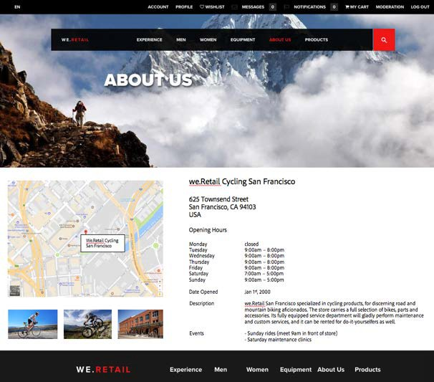
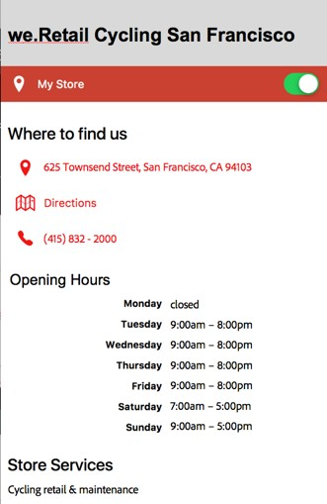
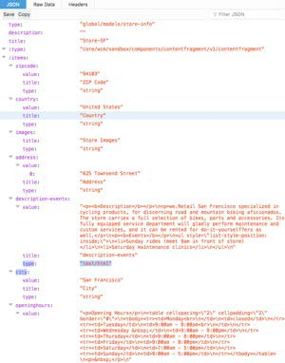
AEM Content Fragments & Services – Use Cases
Create, manage and deliver structured content to any channel
For example
Store locator
User/employee /contact information
Header/footer content

Slide 29



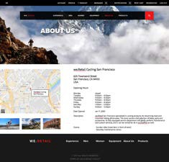
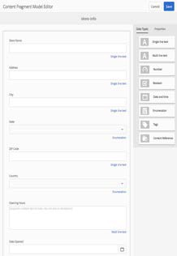
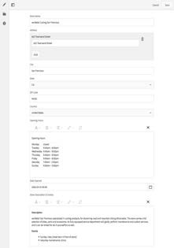

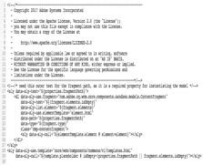
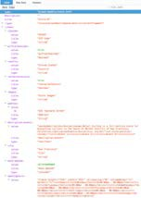






AEM Content Fragments & Services - Personas
1. Information Architect
2. Content Author
3. AEM Developer
4. AEM Web Producer
Web Page
HTML
5. Web Developer
Component
Mobile App Single Page App
...
Content Model
Content Fragment
{API}
JSON

Slide 30

AEM Content Fragments & Services - Technology
AEM (cq:page)
Pages, Sites Apps
Email Other
UNSTRUCTURED CONTENT
COMPONENT
Design Sling Model
MANAGED JSON
Produced by component
MODEL
Text
Numbers, References, Boolean, Enumeration, ...
STRUCTURED CONTENT
Content Fragment Elements, Variations
Non-AEM
Pages, Sites Apps
Email Other
RAW JSON
Produced by AEM API framework

Slide 31
Core Components
AEM Sites components that cover the most common web content needs.
Core Components are
Pre-Configurable Versatile
Easy to Use
Production Ready Accessible
Easy to Style SEO Friendly
PWA/SPA/App Ready Extensible
Open Sourced
Versioned
▪
▪
▪
▪
▪
▪
▪
▪
▪
31

Slide 32


Launched on November 20, 2018
Core Components 2.2.2
Includes 19 components
Provides enhancements for the recently released Tabs and Carousel components
Minimum requirements: 6.3.3.0 & 6.4.2.0
© 2018 Adobe. All Rights Reserved. Adobe Confidential.
4

Slide 33
The Components
Reference components
Template components
Page: Responsive page that works well with the Template Editor.
Navigation: Site navigation that handles globalized structures.
Language Navigation: Displays the language structure of a site.
Breadcrumb: Lists the hierarchy of parent pages.
Quick Search: Incremental search field.
Atomic components
Title: Headings configurable to allow levels 1 to 6.
Text: Plain or rich text with configurable capabilities.
Image: Smart image display with configurable capabilities.
Social components
Sharing: Facebook and Pinterest widgets.
List: Lists pages that match the configured criteria.
Teaser: Visual link to a page teasing its content with an image.
Content Fragment: Displays reusable content.
Carousel: Slideshow presentation of content.
Tabs: Organizes content into accessible tabs.
Form Container: Form paragraph system.
Form Text: Text input field (text, text area, email, phone, date, …).
Form Options: Multi-input filed (checkboxes, radios, drop-down, …).
Form Button: Submit or scriptable button.
Form Hidden: Invisible input field, for sending information along.
Container components
Form components
5

Slide 34
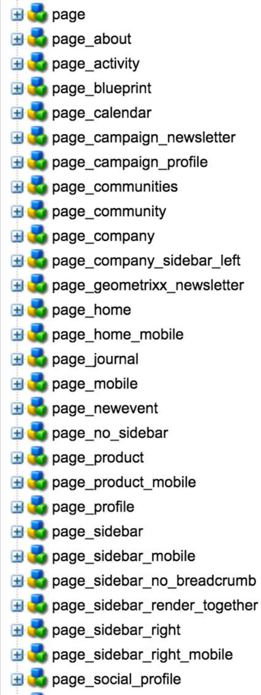

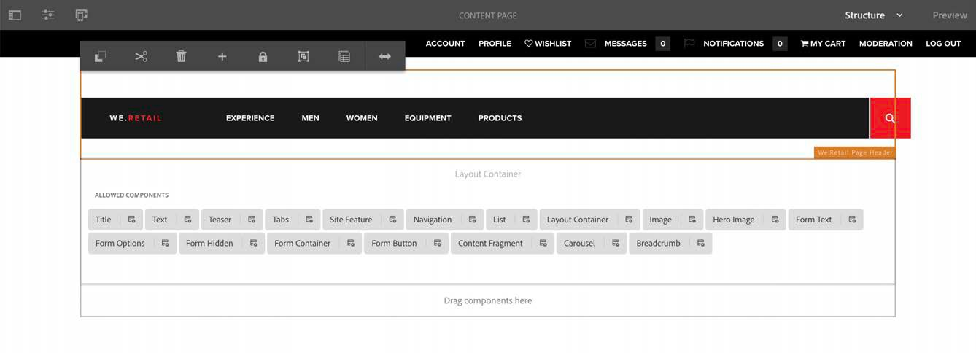

Template Editor
The Core Components require the Template Editor.
Purpose
Replaces the classic UI Design mode.
This is where the components can be pre-configured for the author.
Offers a UI to compose page variations, instead of hard-coding them.
Supports the responsive grid to accommodate for different layout.
© 2018 Adobe. A
ll Rights Reserved. Adobe Confidential. ₆

Slide 35
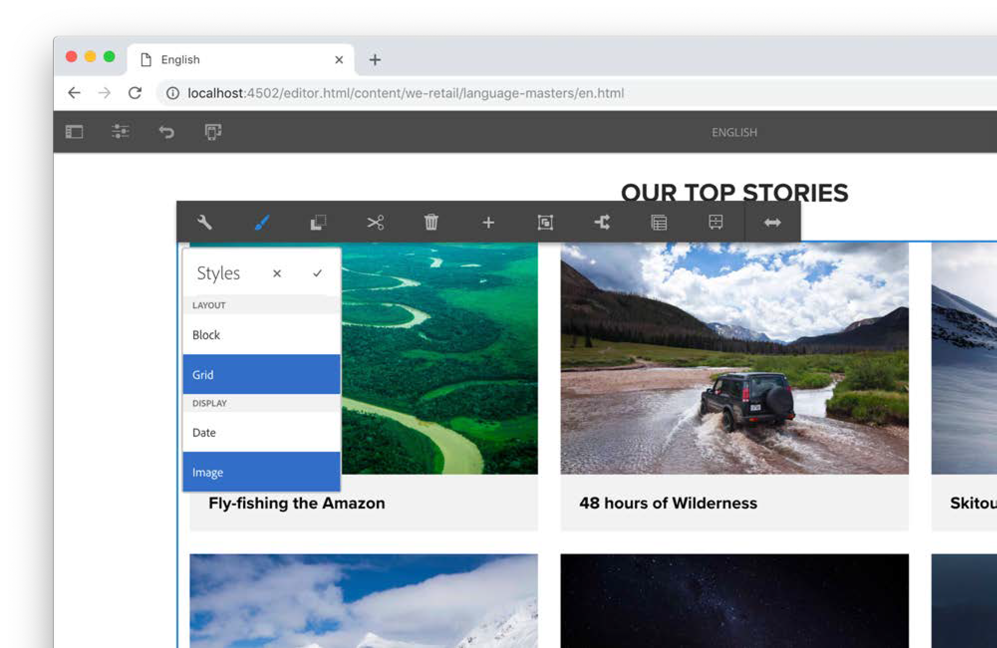



Style System
The Core Components implement the Style System.
Purpose
Allow content authors to apply visual variants to components.
Avoids duplicating the components for just applying a different CSS class to it.
Example of a List component that can have different visual representations, but a single implementation.
35

Slide 36

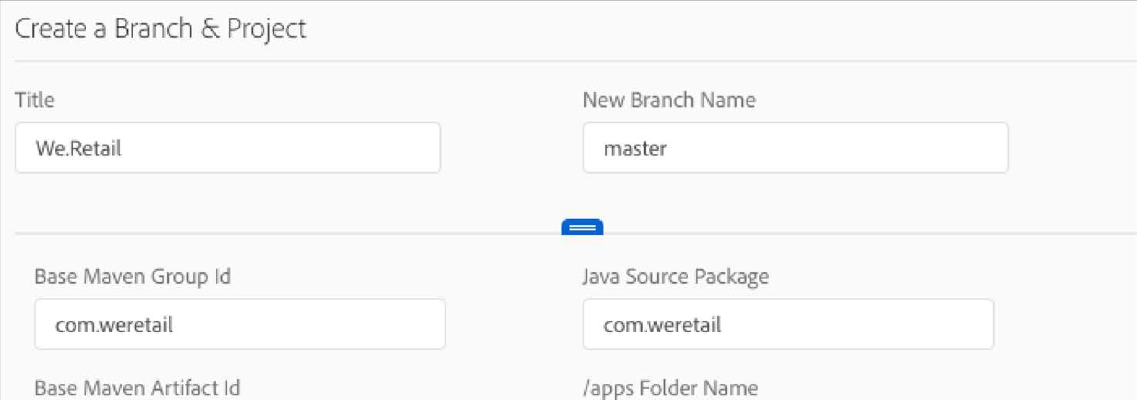
Archetype
The Core Components are featured in the AEM Project Archetype.
Purpose
Template to easily create a new AEM Sites project.
Enables all Core Components capabilities: Template Editor, Style System & Responsive Layout.
The new Cloud Manager provides a UI to create new AEM projects which uses the Archetype.
36

Slide 37
Enough talking!
Show me the demo.
© 2018 Adobe. All Rights Reserved. Adobe Confidential.
9

Slide 38
Anatomy
What makes the Core Components versatile and extensible.
Core Component
Design dialog defines what authors can or cannot do in the edit dialog.
Edit dialog shows authors only the options they are allowed to use.
Sling Model verifies and prepares the content for the view (template).
Result of the Sling Model can be serialized to JSON for SPA use-cases.
HTL renders the HTML server-side for traditional server-side rendering.
HTML output is semantic, accessible, search-engine optimized, and easy to style.
Implement the Style System.
Design dialog
HTL template
HTML output
Edit dialog
Sling Model
JSON output
Content
10

Slide 39





Content Repository
OSGi Java Runtime
CONTENT
/content/my-site/my-page/jcr:content/root
/my-title
sling:resourceType = my-site/components/title jcr:title = Hello World
MODELS
com.adobe.cq.wcm.core.components.models
interface Title
getText()
Resource
Interface
COMPONENTS
/apps/my-site/components
/title
sling:resourceSuperType = core/wcm/components/title/v1/title jcr:title = Title
componentGroup = My Site
/apps/core/wcm/components/title/v1
/title
com.adobe.cq.wcm.core.components.models.impl.v1
Implementation
@Model(adaptables = SlingHttpServletRequest.class, adapters = Title.class,
resourceType = "core/wcm/components/title/v1/title") class TitleImpl implements Title
getText()
Proxy Cmp
Core Cmp
/cq:dialog
/cq:design_dialog
/title.html
<h1 data-sly-use.model="com.adobe.cq.wcm.core.components.models.Title">
${model.text}
</h1>

Slide 40
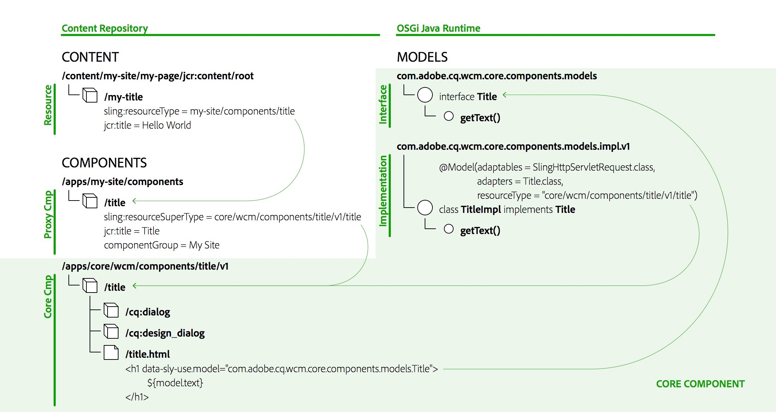

Slide 41
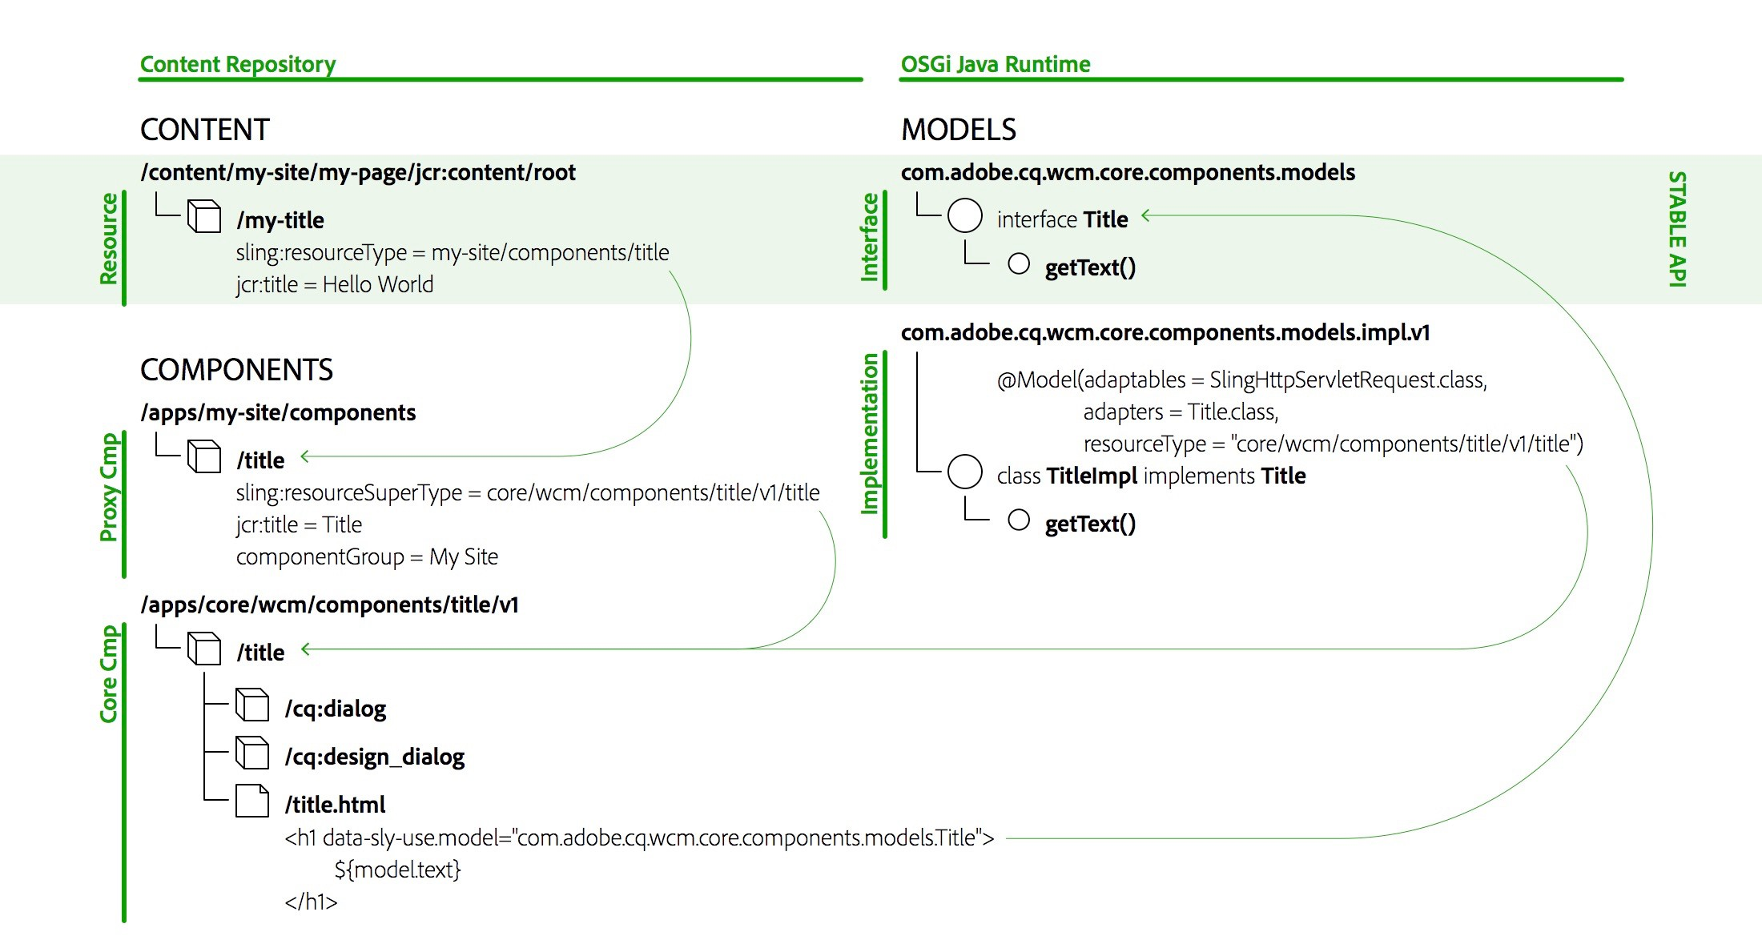

Slide 42
Delegation Pattern for Sling Models
The implementation of the Core Component’s models is private, but can be extended with the delegation pattern.
@Model(adaptables = SlingHttpServletRequest.class, adapters = Title.class,
resourceType = "myproject/components/pageHeadline") public class PageHeadline implements Title {
@ScriptVariable private Page currentPage;
@Self @Via(type = ResourceSuperType.class) private Title title;
@Override public String getText() { return currentPage.getTitle();
}
@Override public String getType() { return title.getType();
}
}
→ https://github.com/adobe/aem-core-wcm-components/wiki/Delegation-Pattern-for-Sling-Models
42

Slide 43
Versioning
Incompatible changes to following aspects of components will result in a new version of them:
Sling Models (following semantic versioning guidelines)
HTL Scripts and Templates
HTML Markup and CSS Selectors
JSON Representation
Dialogs
→ https://github.com/adobe/aem-core-wcm-components/wiki/Versioning-Policies
43

Slide 44
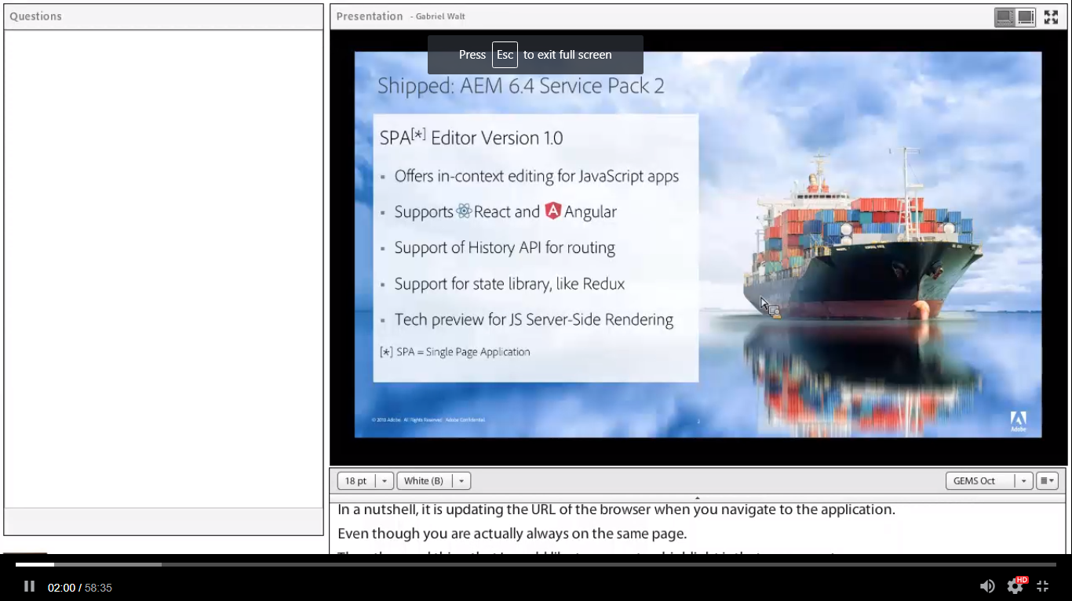

Slide 45
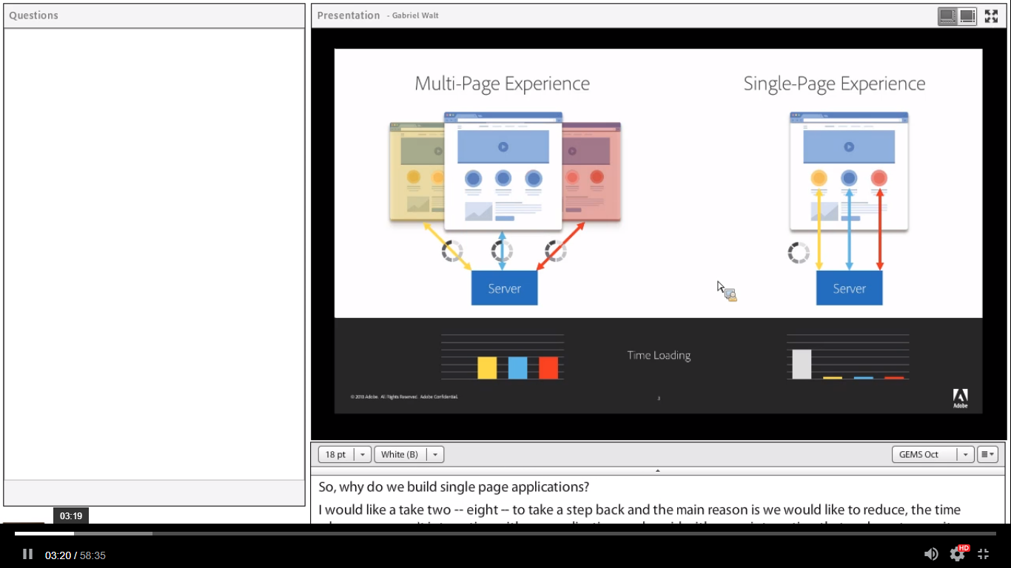

Slide 46
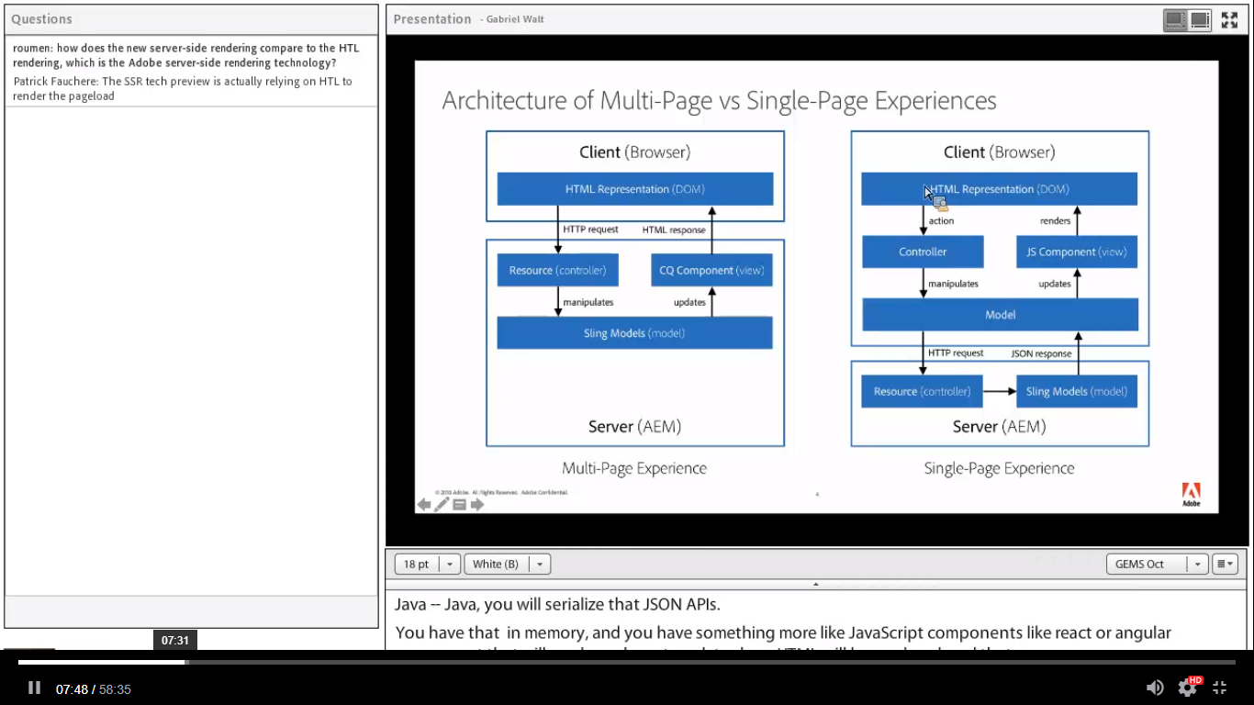

Slide 47
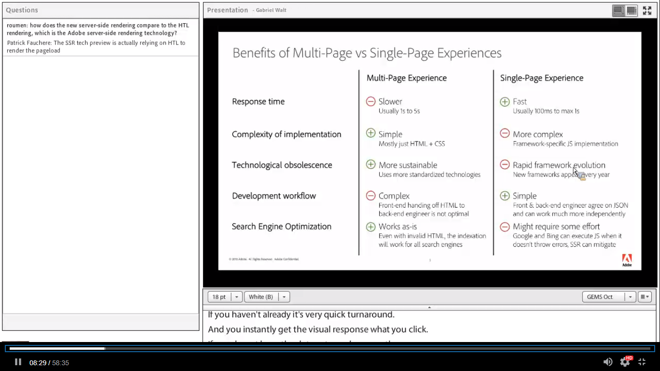

Slide 48
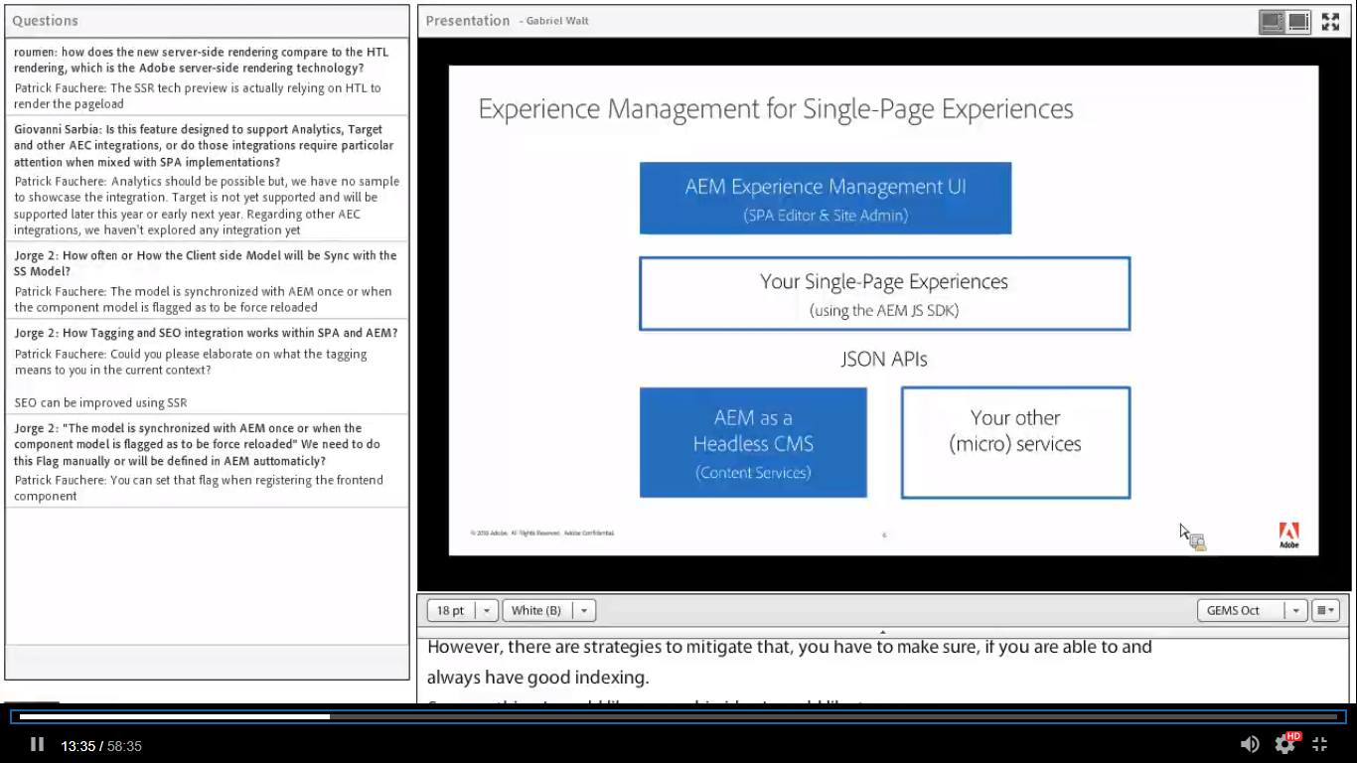

Slide 49
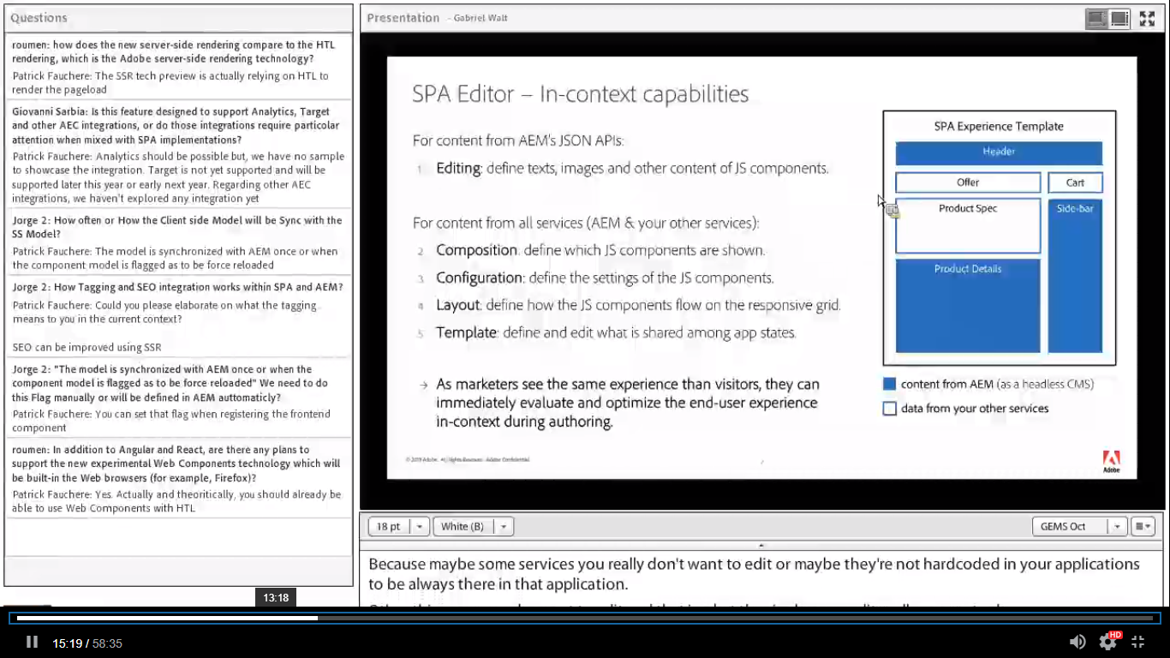
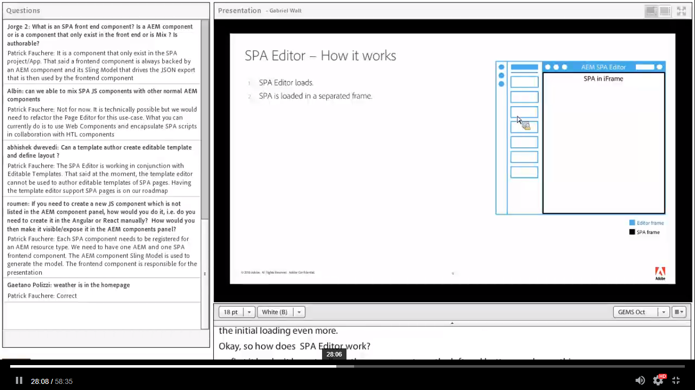

Slide 50
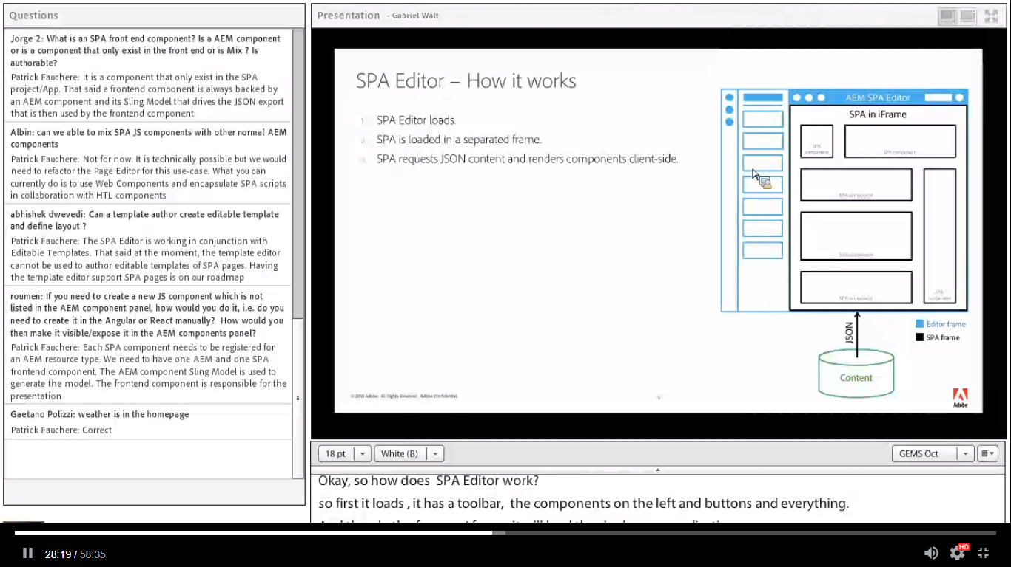

Slide 51
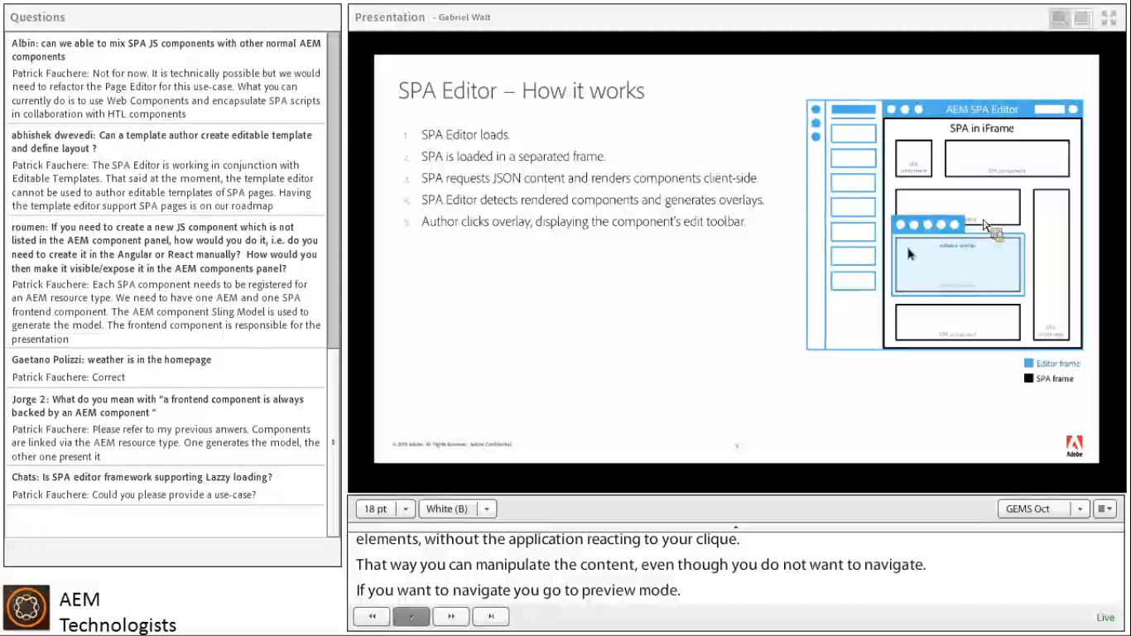

Slide 52
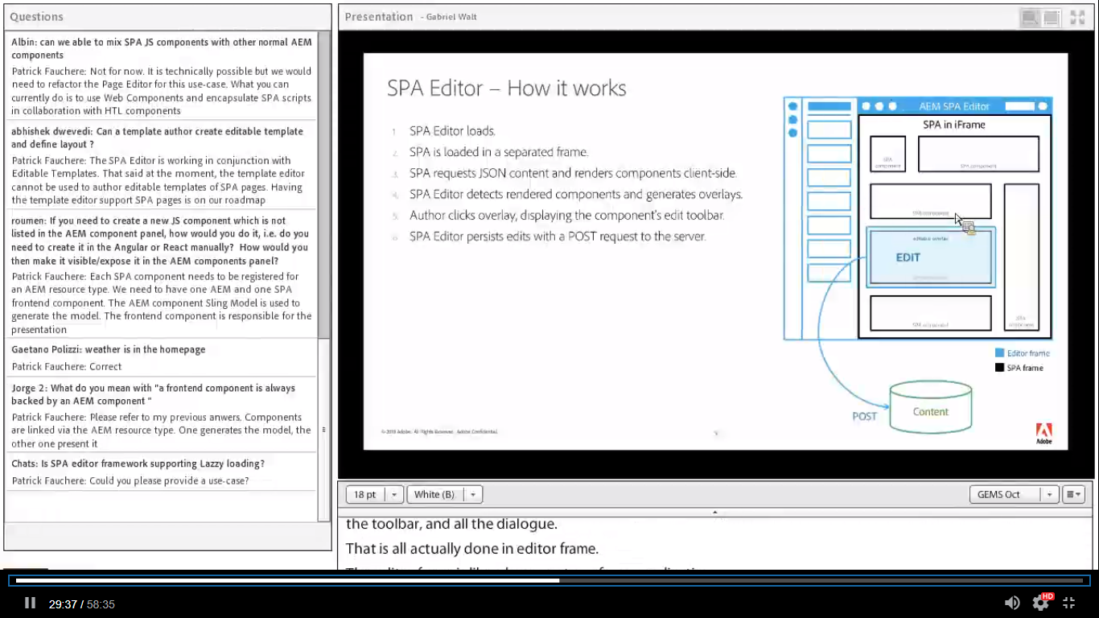

Slide 53
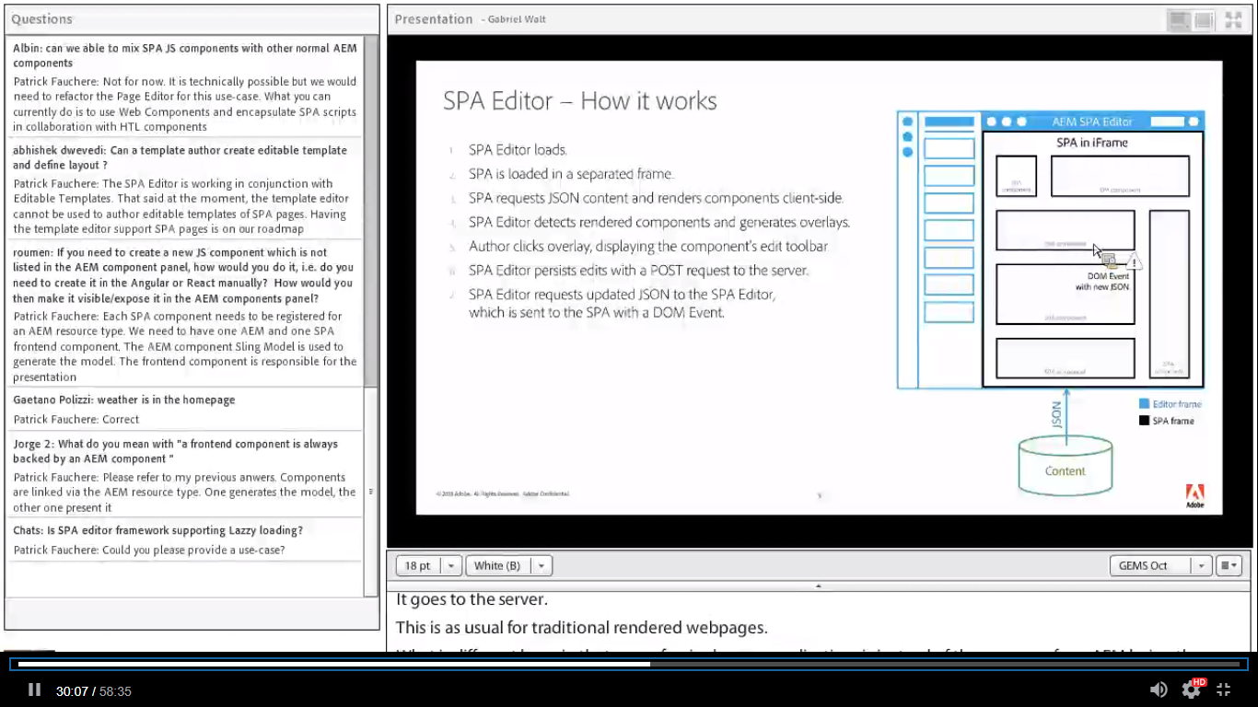

Slide 54
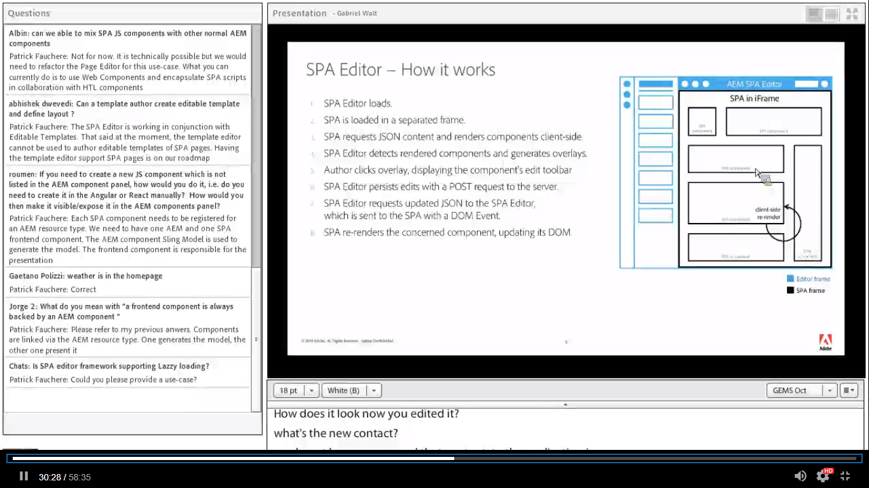

Slide 55
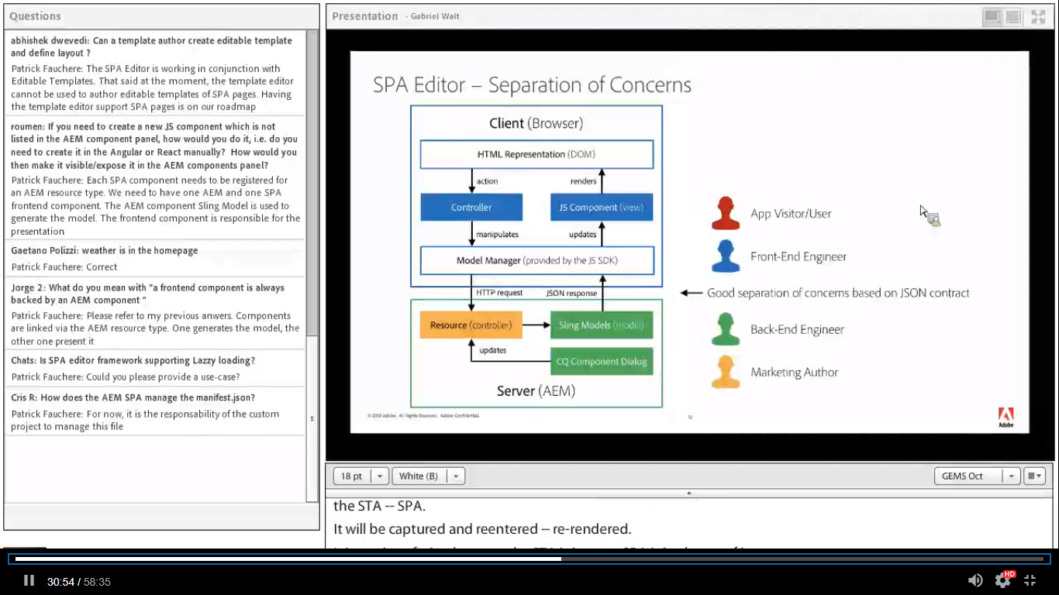

Slide 56
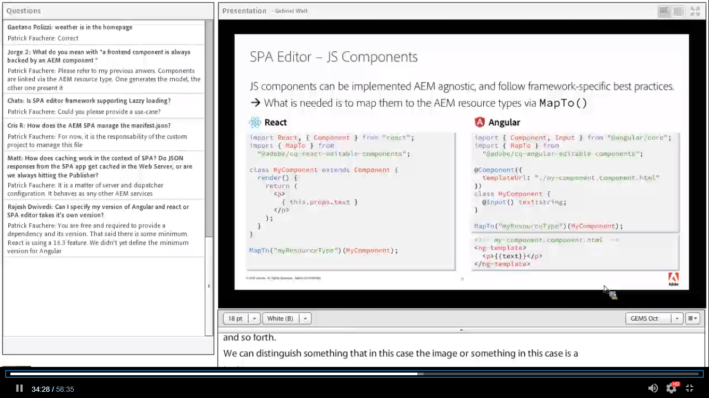

Slide 57
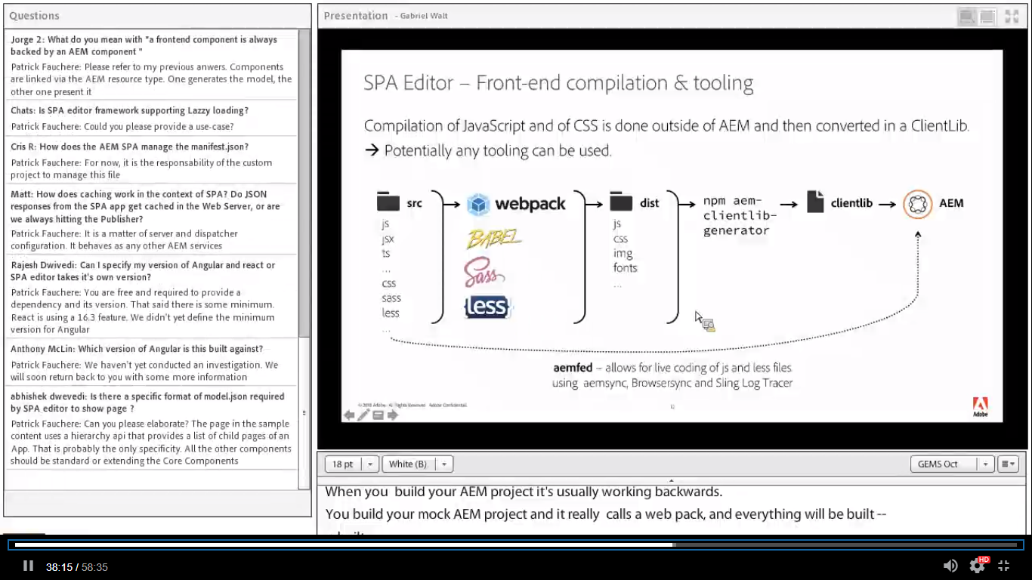

Slide 58
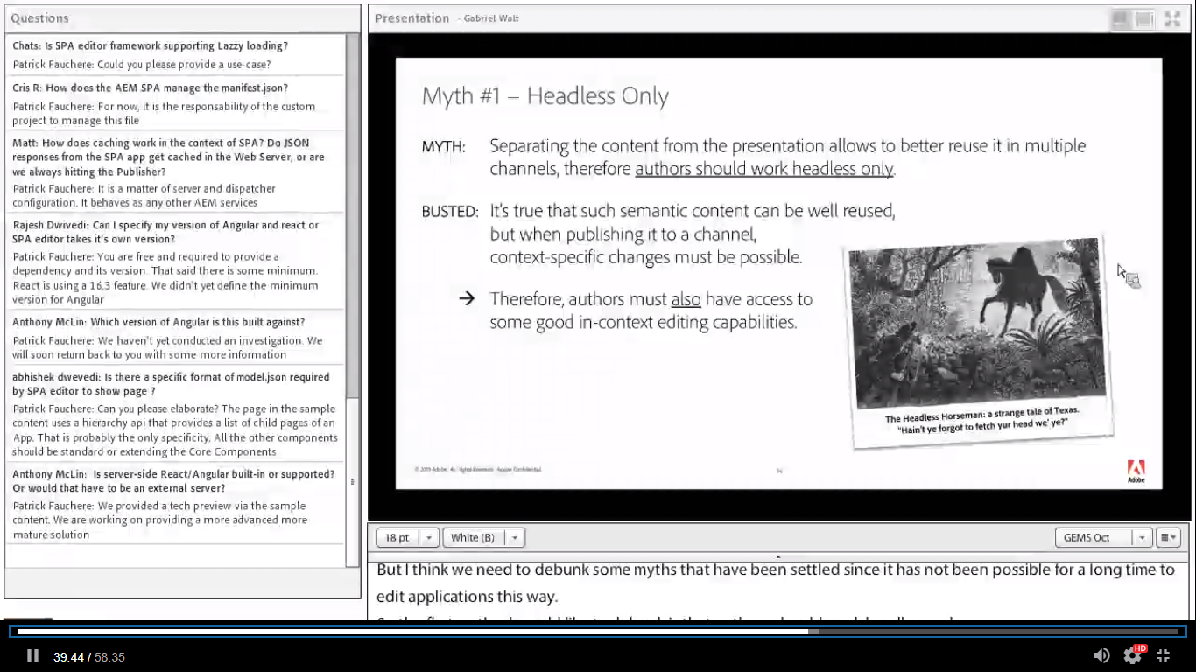

Slide 59
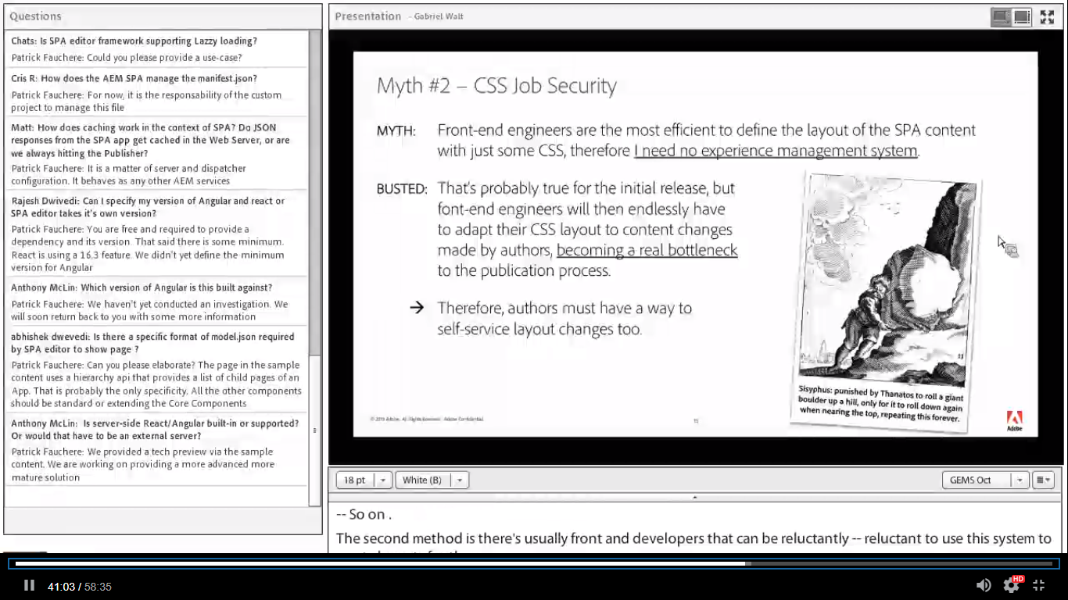

Slide 60
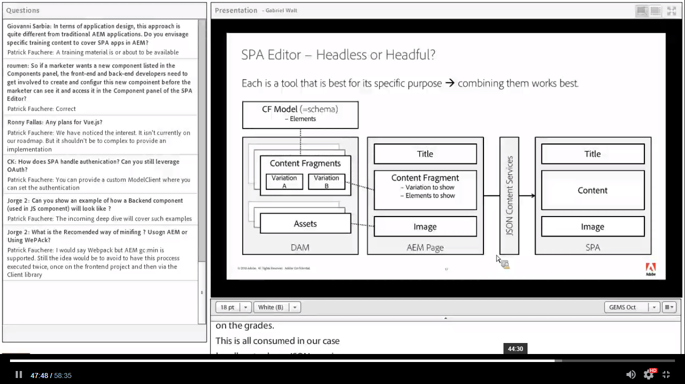

Slide 61
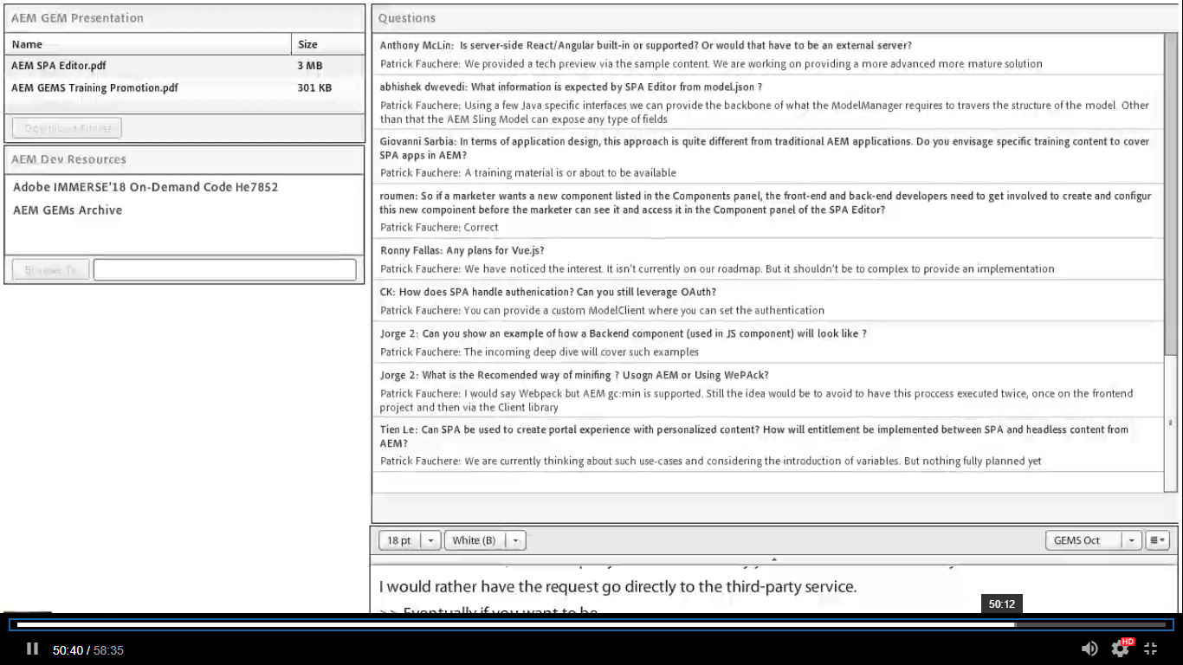

Slide 62


Slide 63


Slide 64


Slide 65


Slide 66


Slide 67


Slide 68


Slide 69


Slide 70


Slide 71


Slide 72


Slide 73


Slide 74


Slide 75


Slide 76


Slide 77


Slide 78


Slide 79


Slide 80


Slide 81


Slide 82


Slide 83


Slide 84

Agenda
Project Structure
AEM Page Component
Content Services
SPA Initialization
Frontend Component
Container components
Model Manager and Provider
App Routing and Model Router
© 2018 Adobe. All Rights Reserved. Adobe Confidential.
1
Notes:
Presenter
2018-10-31 13:54:54
--------------------------------------------
Project Structure AEM project Frontend project
Client library generator AEM Page Component HTL template Hierarchy Page
Hierarchy structure configuration Content Services
export.json and hierarchy API

Slide 85
Project Structure

Slide 86

Project Structure
Team and project composition
Single Project with modules
The frontend project is one of the modules
2 projects
A project for the AEM modules
A project for the frontend App
3
Notes:
Presenter
2018-10-31 13:54:54
--------------------------------------------
Full-stack developers
with complete or partial expertise
Frontend developers with small AEM expertise AEM developers with small frontend expertise
Single team with a split between frontend or AEM developers Split teams divided between frontend and AEM developers Same company
Different companies

Slide 87
Project Structure
Breakdown
AEM area
Bundles
AEM Component Sling Model
Servlets (e.g. Server-Side Rendering)
Content
AEM Component HTL templates
Editable Templates and Content Policies
Content Structure and component data of the App
Frontend area
Frontend components mapped to AEM component resource types
4
Notes:
Presenter
2018-10-31 13:54:55
--------------------------------------------
Breakdown bundles
Sling Model configuration content
/apps
Components and Client Libraries
/conf
Editable Templates and Content Policies
/content Page content
Frontend App project

Slide 88
Project Structure
Client library packaging and delivering strategies
Copy in the content directory (full-stack project structure type)
npm: aem-clientlib-generator
Direct Upload (any project structure type)
npm: aemfed
5

Slide 89
AEM Page Component

Slide 90

AEM Page Component
HTL template
Meta properties
Initialize the PageModelManager
cq:datatype -> Format in which to fetch the data and to update the page model (JSON)
cq:wcmmode -> WCMMode edit or preview (Author instance only)
cq:pagemodel_root_url -> URL to the model of the App root (incl. selectors)
Notes:
Presenter
2018-10-31 13:54:56
--------------------------------------------
Datatype and WCM Mode
Mandatory, invariable and relates to the context of the Page Editor

Slide 91
AEM Page Component
Root model
Initial model of the SPA
Common content
Pre-loaded page models
Notes:
Presenter
2018-10-31 13:54:56
--------------------------------------------
Root URL
Illustrate with an example Access the SPA using any page You would expect
Pre-loaded pages
Shared content to be available

Slide 92
AEM Page Component
HTL template
Client library categories
Files: customheaderlibs.html , customfooterlibs.html
data-sly-call="${clientLib.js @ categories='cq.authoring.pagemodel.messaging’}”
data-sly-call="${clientlib.<js|css> @ categories=‘my-spa-category'}"
Body of the page
File: body.html
<div id="page"></div>
Notes:
Presenter
2018-10-31 13:54:57
--------------------------------------------
Client library categories Optimization
Javascript resources at the end of the body

Slide 93
AEM Page Component
Hierarchy Page
Initial JSON representation of the App
Instant and asynchronous model
Flat list of child pages (Root model)
Content Policy properties
isRoot -> Identifies the page as the root of an App
structureDepth -> Maximum depth of the lookup for pages to be added to the root model
structurePatterns -> List of regular expressions to remove pages from the root model

Slide 94
Content Services

Slide 95
Content Services
Model Selector
.model.
Multiple selectors?
Model selector must come first
Default name
Also used by the Core Components
/content/my-site/my-page.model.json
12

Slide 96

Content Services
JSON representation of the content
Leverage the Sling Model Exporter
Meta fields (reserved)
:type -> Resource type of an AEM component
:items -> Map of child components
:itemsOrder -> Ordered list of the item keys
:children -> Map of child pages
:path -> Path to the resource
13
Notes:
Presenter
2018-10-31 13:54:57
--------------------------------------------
Meta fields Items
Tree of items in a page Children
Child pages of a page Type
Resource Type Path
Path of a page
A Sling Model is mandatory Can be inherited
Proxy the Core Components to work faster and use the delegation pattern Fallback doesn’t allow the edition

Slide 97
Content Services
Sling Model
Mandatory for the SPA SDK
Schema of the component
Business logic
export.json API
ComponentExporter.class
ContainerExporter.class
HierarchyNodeExporter.class
Core components
Sling models
Use the export.json API
14
Notes:
Presenter
2018-10-31 13:54:58
--------------------------------------------
A Sling Model is mandatory Can be inherited
Proxy the Core Components to work faster and use the delegation pattern Current Fallback mechanism doesn’t allow the edition
Adapters
Adapt to ComponentExporter.class, ContainerExporter.class

Slide 98
SPA Initialization

Slide 99

SPA Initialization
Explore the frontend project
Project bootstrap
Initialize the ModelManager
Meta properties
URL of the root model
ModelClient
Instantiate the components
Notes:
Presenter
2018-10-31 13:54:58
--------------------------------------------
Meta properties: Initialize the ModelManager with data from the server Page Model Root URL
Model URL resolution fallbacks
Function parameter, meta property, browser pathname ModelClient: customize the request

Slide 100
SPA Initialization
Dynamic instantiation of the complete page
ReactDOM.render((<App cqChildren={pageModel[Constants.CHILDREN_PROP]} cqItems={pageModel[Constants.ITEMS_PROP]}
cqItemsOrder={pageModel[Constants.ITEMS_ORDER_PROP]}
cqPath={pageModel[Constants.PATH_PROP]}/>), document.getElementById('page’));
Why do we have to set so many fields?
Done once when bootsrapping the App
We already receive the model after the initialization of the ModelManager
We are considering the introduction a helper
Notes:
Presenter
2018-10-31 13:54:59
--------------------------------------------
Instantiation of Components Dynamic
Container + :items Static
cqPath

Slide 101
SPA Initialization
Static Instantiation of a component
// Component file
let MyEditableComponent = withAsyncModel(MapTo(‘component/resource/type’)(MyComponent, EditConfig));
export {MyEditableComponent};
…
// Bootsrap file
import {MyEditableComponent } from "./components/EditableComponent";
<MyEditableComponent cqPath={‘/absolute/path/to/my/resource’}/>
Notes:
Presenter
2018-10-31 13:54:59
--------------------------------------------
withAsyncModel Using cqPath
Leverage an Async component
Get the data from the ModelManager Propagate the props
Spread the model

Slide 102
Frontend Component

Slide 103
Frontend Component
Register
MapTo
Maps an AEM component type to a Frontend component class
Store the Class in the ComponentMapping
Composition
withEditContext -> Authoring context
withModel -> Access to the model of a component
withEditable -> Decorate the component with the data that enables authoring capabilities
export MapTo(‘component/resource/type’)(Component, EditConfig)
20
Notes:
Presenter
2018-10-31 13:54:59
--------------------------------------------
Register
Export the component returned by the MapTo function to benefit from the features provided by composition withEditContext
withModelProvider withEditable
Configure the authoring experience Empty label
Is empty function
Relates to AEM properties Composition pattern withEditable

Slide 104
Frontend Component
Configure the authoring experience
EditConfig
emptyLabel -> Label for the placeholder of an empty component
isEmpty -> Is the (AEM) component empty
export MapTo(‘component/resource/type’)(Component, EditConfig)
21
Notes:
Presenter
2018-10-31 13:55:00
--------------------------------------------
Register
Export the component returned by the MapTo function to benefit from the features provided by composition withEditContext
withModelProvider withEditable
Configure the authoring experience emptyLabel -> translation frontend-side isEmpty function
Relates to AEM properties Composition pattern withEditable

Slide 105
Container components

Slide 106
Container components
Extensible components
Container
Dynamic instantiation of components
ResponsiveGrid
Provide access to the layout class names
Page
Dynamic instantiation of child pages
Read the :children field of the model
© 2018 Adobe. All Rights Reserved. Adobe Confidential.
23

Slide 107
Model Manager and Provider

Slide 108
Model Manager and Provider
ModelManager
Stores the model
Caches the model
Allows to asynchronously load fragments of model
Returns the immutable model of a component
Is updated by the Page Editor
Can force reload the model of a component
25

Slide 109
Model Manager and Provider
ModelProvider
Listens to model changes by resource path
Model fields to component properties transformation
Utils.modelToProps(model)
myProp -> this.props.myProp
:type -> this.props.cqType (reserved)
26
Notes:
Presenter
2018-10-31 13:55:01
--------------------------------------------
modelToProps converts the colon character into a cq prefix and makes the property name a camel case E.g. :type into cqType

Slide 110
App Routing and Model Router

Slide 111
App Routing and Model Router
App Routing relates to the navigation the App
The Model Router
Pre-fetch fragments of model
Listen for calls to the History API
Enabled by default
Meta properties to initialize the ModelRouter (Optinal)
cq:pagemodel_route_filters -> array of regular expressions to ignore routes
cq:pagemodel_router -> to disable the router
28
Notes:
Presenter
2018-10-31 13:55:01
--------------------------------------------
Triggers the ModelManager to pre-fetch fragments of model Optionally, Provokes a re-rendering of the site to include a new page

